Slide 1
Unordered_Map
With Lambda function and for_each

Slide 2
What is unordered_map?
In Python it is called dictionary.
In Java it is called hashmap.
In JavaScript it is called map.
It is an unordered collection of data.

Slide 3
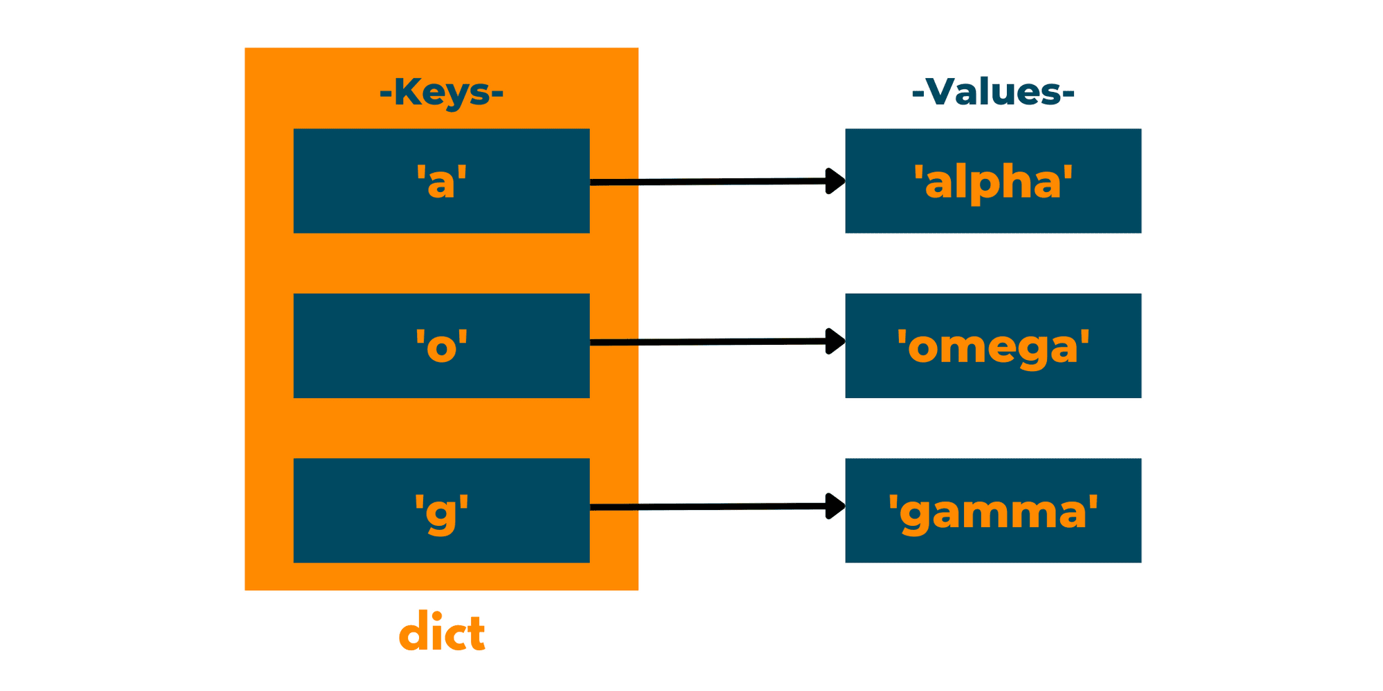
What is unordered_map?
Has a key – value pair.
Keys must have same data type and so does values.
Keys will be always unique.
Offers average O(1) time complexity for insertions, deletions, and lookups.

Slide 4
How it works?
It uses hashing to quickly find where each key-value pair should go.
Each key is passed through a hash function which turns it into a number.
That number decides at which index the value goes.
Same index means same location for two values.
Does not maintain order.

Slide 5
Where it’s useful?
Word counting
Caching results
Graph adjacency lists
Counting frequency of elements in linear time

Slide 6
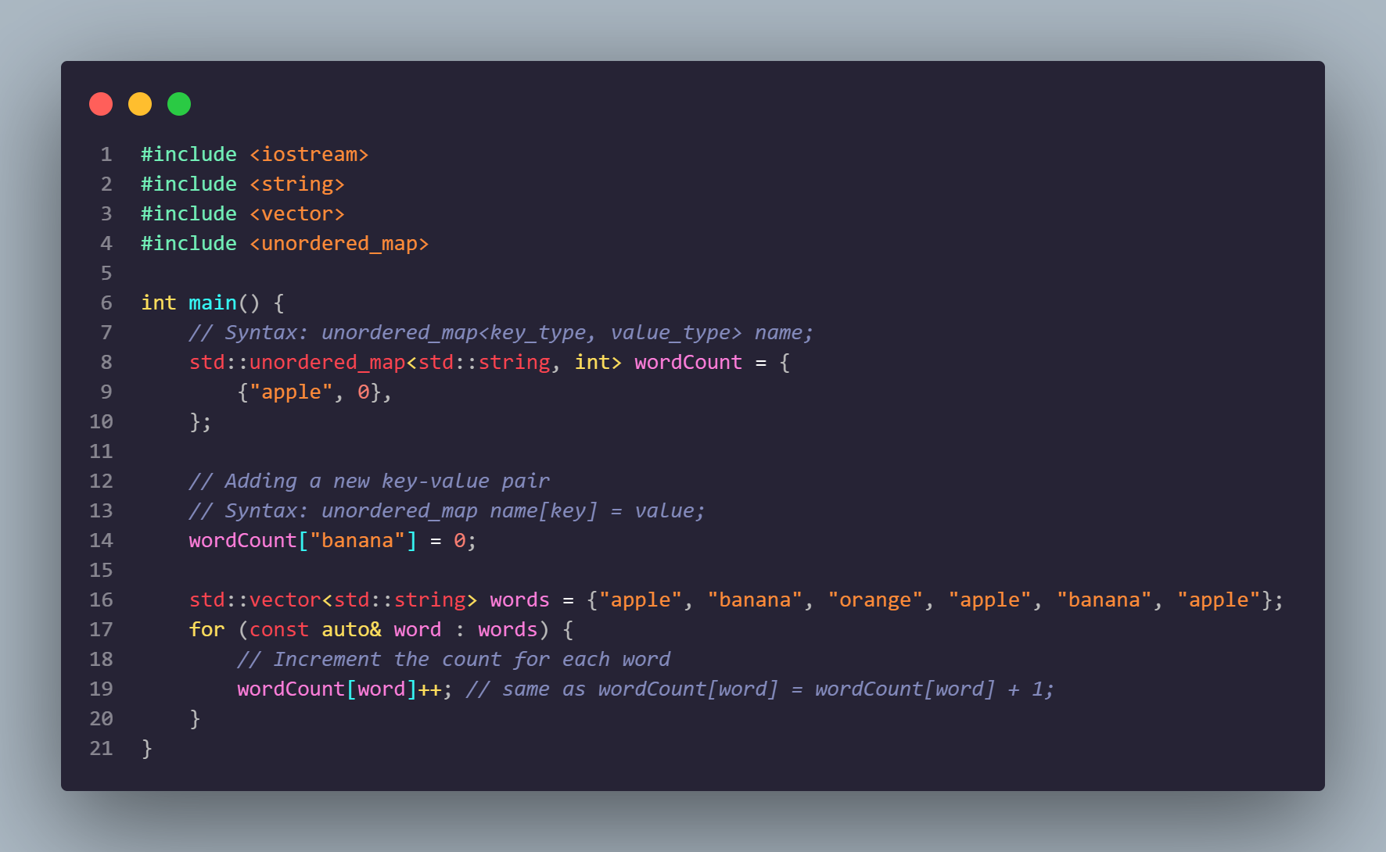
Code example

Slide 7
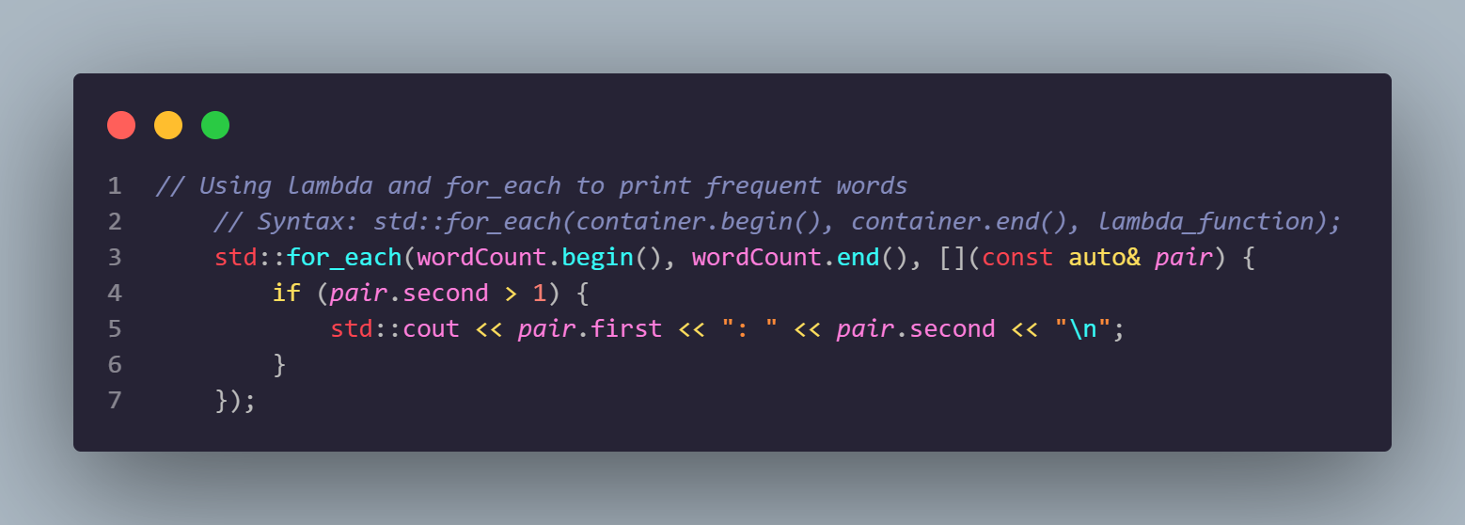
Using Lambda and for_each

Slide 8
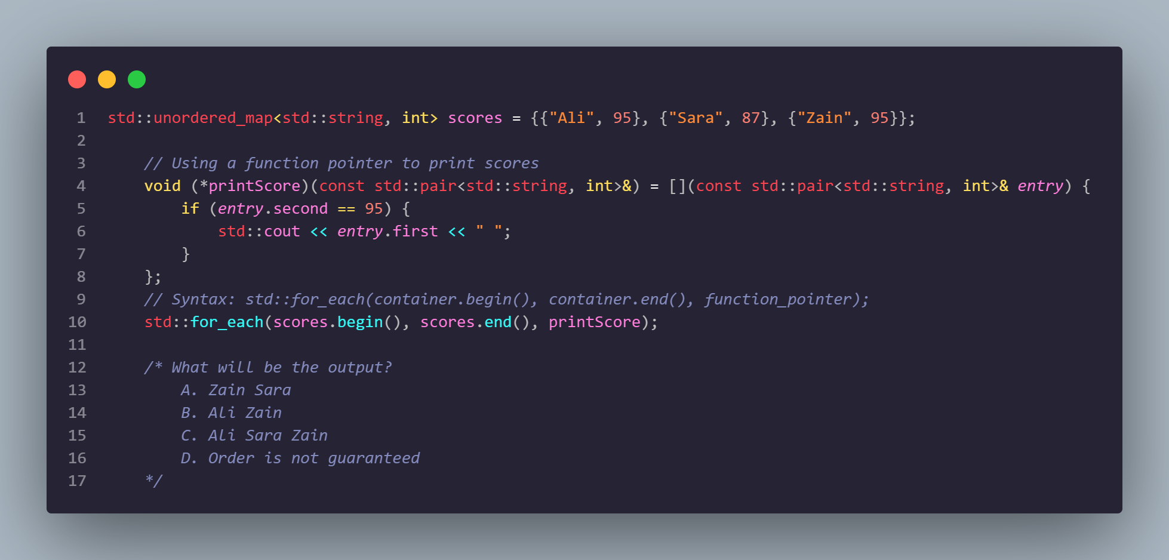
Question

